Slide 1
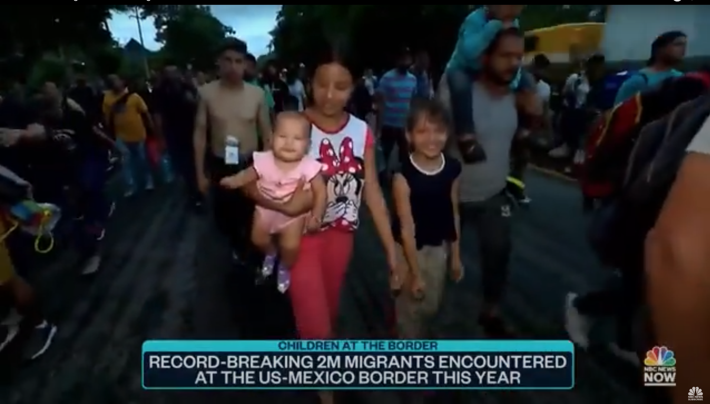
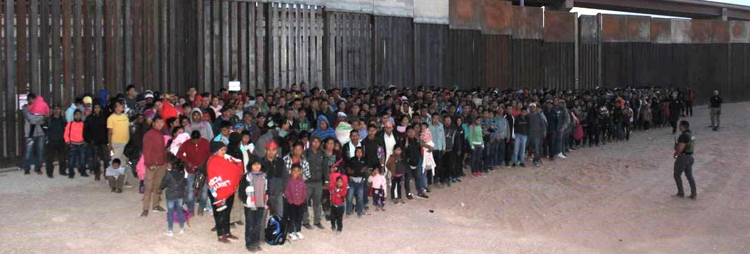
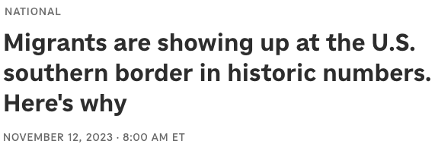

Slide 2
Immigration under Biden
(Title 8 Only:)
2020: 49,693
2021: 671,160
2022: 1,299,437
2023: 1,911,289
2024: 2,033,260

Slide 3
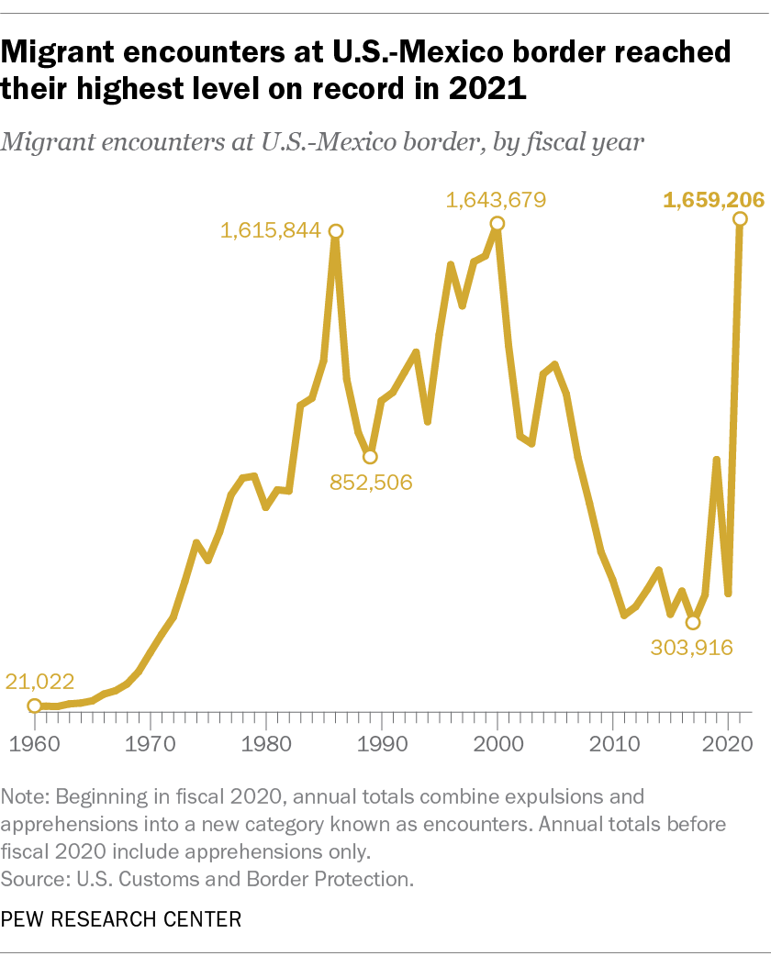

Slide 4
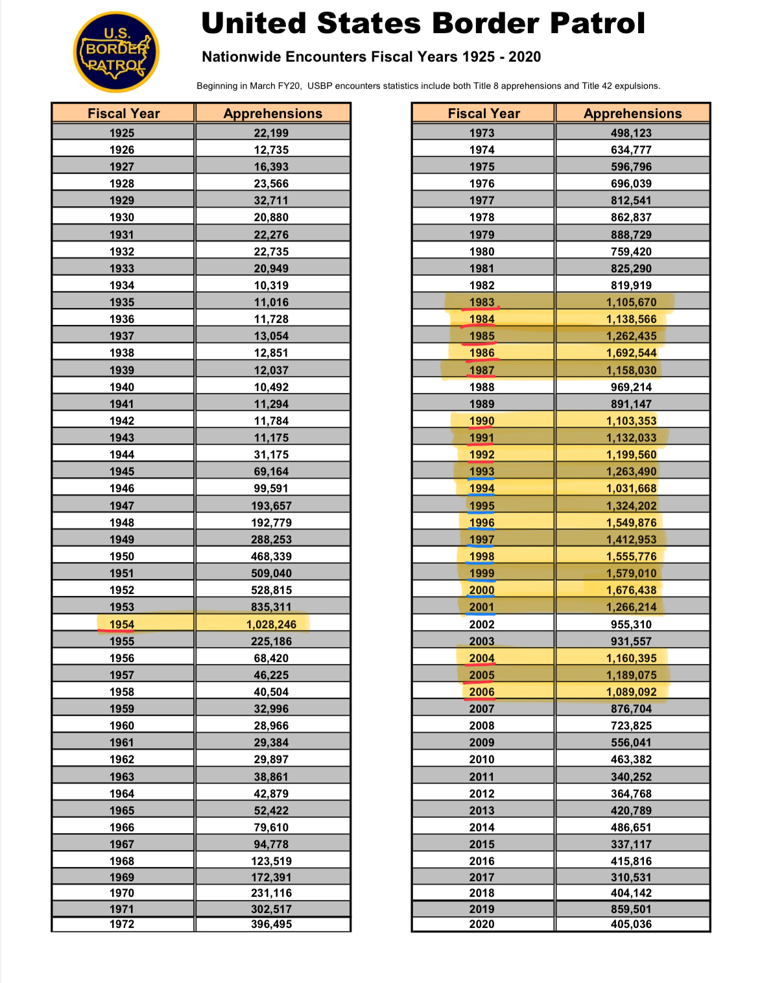
Republicans: 12
Democrats: 9

Slide 5
Words to avoid
Unprecedented…
Most ever…
Least ever…
Record-breaking…
First time/most/least “in modern history…”

Slide 6
Tell the whole story
Politics
Business
Science/Health
Education
Public Safety/Criminal Justice
Foreign Affairs
History
Resources: Academia (check Google Scholar), Migration Policy Institute, Center for Migration Studies, Congressional Research Service

Slide 7
Get comfortable with data
Take a NICAR workshop!
But don’t stop there, go beyond the numbers…
Go

