Slide 1
Using Academic Research to Keep Politicians Honest:
A free training for journalists across beats

Slide 2
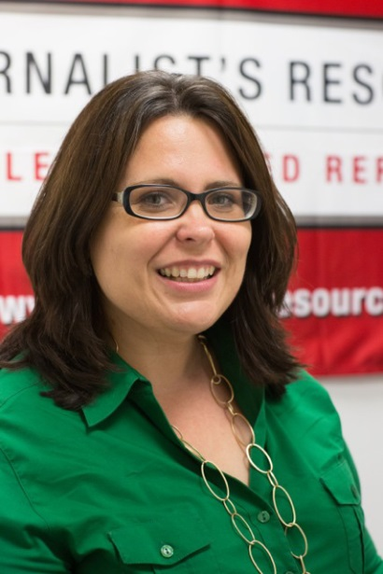
Your presenter
Denise-Marie Ordway is managing editor of The Journalist’s Resource at Harvard’s Shorenstein Center for Media, Politics and Public Policy.

Slide 3
A few logistical things
Use the Q&A feature to ask questions.
I can stay on afterward for add’l questions.
This session will be recorded.
Check the chat box for tip sheets.

Slide 4
Today’s plan
Why reporters should academic research
The best ways to find it
Translating for the public
Dos and don’ts
How to tell good studies from questionable ones
Q&A

Slide 5
What’s academic research?
A scientific or scholarly investigation
Often by college or university faculty
Peer reviewed
Published in academic journals
(Photo by Syd Wachs/Unsplash)

Slide 6
Why we need to use it
Academic research is great for:
Getting up to speed on a topic, trend or idea.
Getting a sense of whether a policy proposal will succeed or have unintended consequences.
Getting ideas for other angles to pursue.
Checking facts and figures.
Checking people’s statements.
Understanding how the public feels about a problem or issue.
Understanding how journalists’ work affects a group/problem.

Slide 7
Accountability journalism
Academic research is one of journalism’s best-kept secrets for:
Holding agencies accountable.
Keeping politicians honest.
Preventing and fighting disinformation.

Slide 8
Example 1
Claim: Increasing taxes on tobacco reduces smoking among young people.

Slide 9
What research says
A paper published last year in PLOS One (Public Library of Science) finds that the established smokers studied actually smoked more after a tax increase.
It finds: Smoke-free laws are more effective across most types of smokers.
The authors suggest a combined approach: comprehensive smoke-free ordinances, a higher tax and a minimum floor price.

Slide 10
Example 2
A developer comes before the County Council with a proposal to build a sports stadium and presents an economic impact study that shows the project would have a $150 million impact on the area.

Slide 11
What research says
Multiple published studies question the reliability of economic impact studies and note government officials often don’t have the training to detect problems in the way data has been collected, analyzed or presented.

Slide 12
Example 3
As communities and organizations wrestle with how to tackle a problem, use research to help audiences understand what works (or has shown promise elsewhere).

Slide 13
What does research say?
Do students learn more when class sizes are smaller?
What kinds of public information campaigns help correct bad information about vaccines (or could backfire)?
Which initiatives boost voter participation?
In what ways have cities successfully reused abandoned buildings and property?
What works in preventing suicide among veterans?

Slide 14
Where to find research
Academic journals (paywall & OA)
Colleges
Research organizations
Individual faculty
Libraries
Preprint collections
Google Scholar
(Photo by Plumlord/Pixabay)

Slide 15
Why I Google Scholar
Free search engine that indexes research.
Easy to use.
Often offers free copies (or links to them).
Offers citation numbers.
Lets you create alerts.
(Photo by JETSHOOTS-com/Pixabay)

Slide 16
A few tips about journals
Some journals focus on specific subjects (Criminology, Review of Educational Research, New England Journal of Medicine).
Some publish research on various topics (Social Problems, Proceedings of the National Academy of Sciences).
If you only check certain journals, you’ll miss something.

Slide 17
Tip #1: Don’t make assumptions about research quality based on the institutions involved.
Don’t assume a study is bulletproof because it’s from a prestigious university.

Slide 18
Tip #2: Don’t spend too much time on the abstract.
What researchers consider the most important elements of a study may not match what a reporter thinks is most compelling. Often, the “golden nuggets” are inside.

Slide 19
Tip #3: Look for the limitations.
Good researchers go out of their way to point out the shortcomings and potential biases in their study’s design, how data was collected and the data used and their findings.
Explain findings with these limitations in mind.

Slide 20
Tip #4: If it’s not clear, ask who’s affected by the findings. Sometimes, it’s hard to tell.
Study findings often are not generalizable.
If you’re reading a study focusing on teenagers, do the findings apply to teenagers in one specific community? Urban cities of a certain size? Certain states? Nationwide? Worldwide?

Slide 21
Tip #5: Be careful about inferring causation.
Just because something changes in the presence of something else does not mean that thing caused the change being observed.
If ice cream sales spike at the same time hospitals report more waterskiing injuries, that doesn’t mean ice cream causes waterskiing injuries.

Slide 22
Tip #6: Significant ≠ Noteworthy
When researchers characterize a finding as “significant” they usually are talking about statistical significance.

Slide 23
Tip #7: Mean and average are the same thing. But the median is the middle number.
Example: 5 kids earn these test scores: 43, 69, 80, 93, 95
Average: 43+69+80+93+95/5 = 76
Median: 80

Slide 24
Tip #8: Don’t say (unless the researcher explicitly states it or confirms it’s true):
This study proves …
This study shows this thing causes …

Slide 25
Tip #9: Reach out to the author.
An author can explain what a study does and does not say. They can tell you what other questions/angles need examining and who else you should talk to.

Slide 26
Indicators of quality
Published in a peer-reviewed journal.
Appears in a top journal.
Researchers have expertise, publishing history.
Researchers don’t have conflicts of interest.
Presents all data, statistical models.
Explains limitations.
Findings are supported by the data.
Meta-analyses/meta-studies are among the most reliable.

Slide 27
Cause for pause
Studies from advocacy or partisan groups.
Studies from a person who stands to gain from the findings.
Studies that are old (“old” is relative).
Studies that exaggerate or minimize findings.
Studies that don’t explicitly point out their limitations.

Slide 28
7 tip sheets to check out
How they did it: Tampa Bay Times reporters uncover predictive policing project used to harass residents, profile kids
How to tell good research from bad: 13 questions journalists should ask
What’s peer review? 5 things you should know before covering research
5 tips for avoiding mistakes in news headlines about health and medical research
5 common research designs: A quick primer for journalists
Covering scientific consensus: What to avoid and how to get it right
7 ways journalists can access academic research for free

Slide 29
Before we go:
JournalistsResource.org
@JournoResource
Sign up for our weekly newsletter!
My email: denise-marie_ordway@hks.harvard.edu

